Slide 1
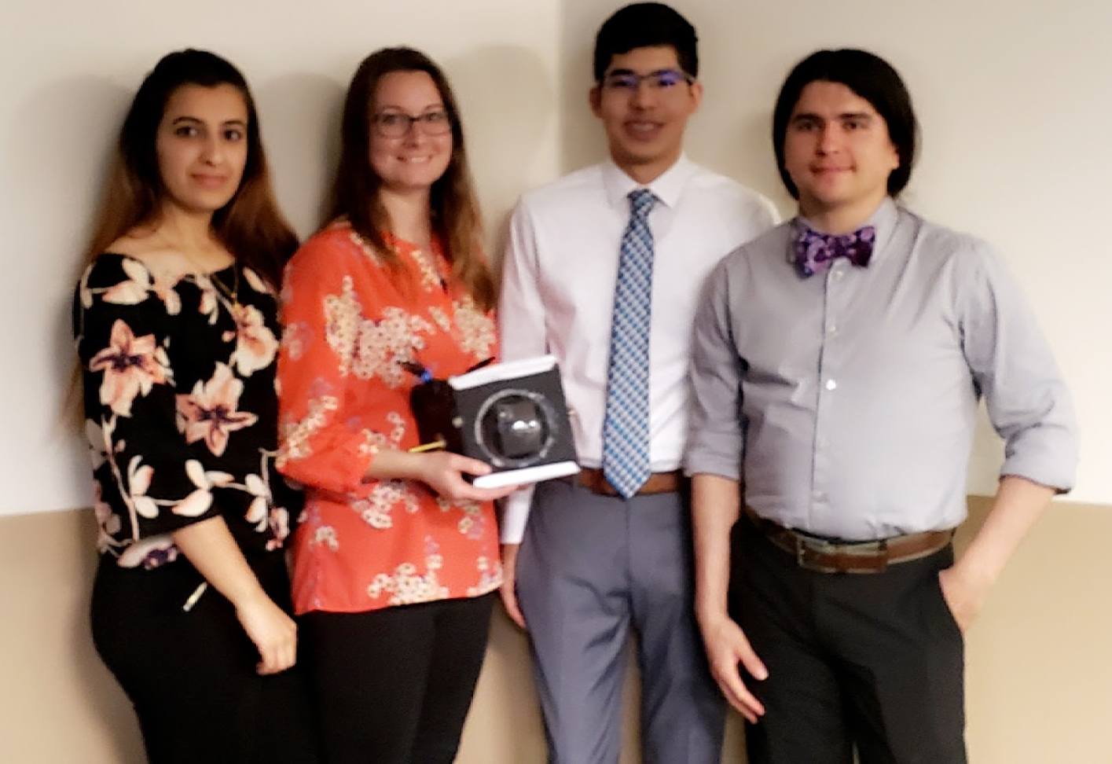
Flat Earth Society
Jose Inzunza Juan Pablo Garcia
Jennifer Bartelme Marina Sliwo

Slide 2
Objectives
Minimum
Weight
Imaging
Sensors
Desired
Biology
Telemetry
GPS
Runcam
System Block Diagram

Slide 3
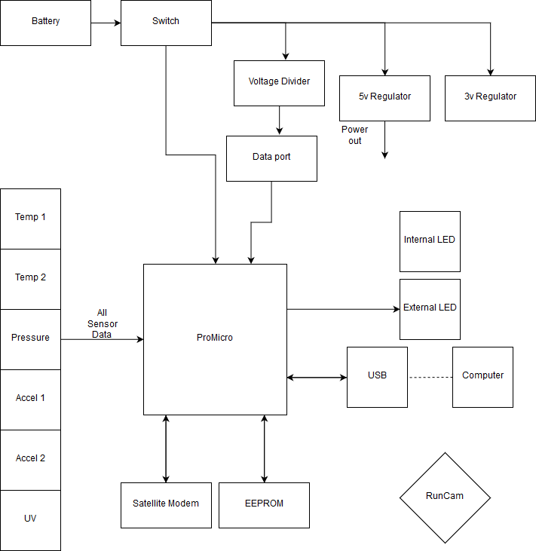
System
Block Diagram

Slide 4
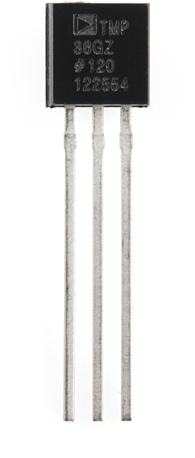
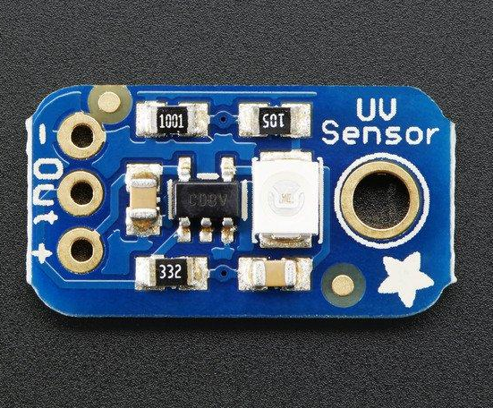
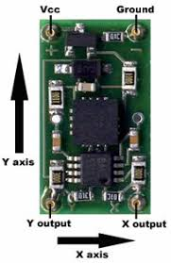
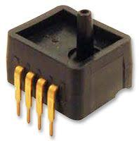
System Components
Temperature
Sensor Internal
And External
UV Sensor
Accelerometer
Pressure

Slide 5
Payload Assembly

Slide 6
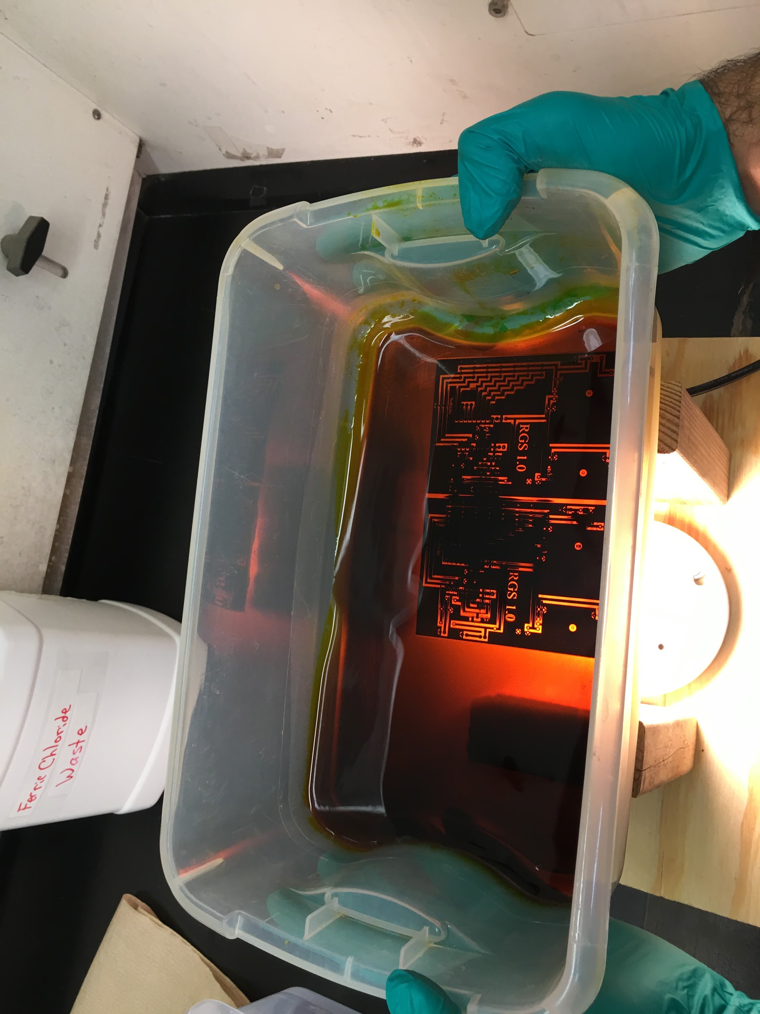
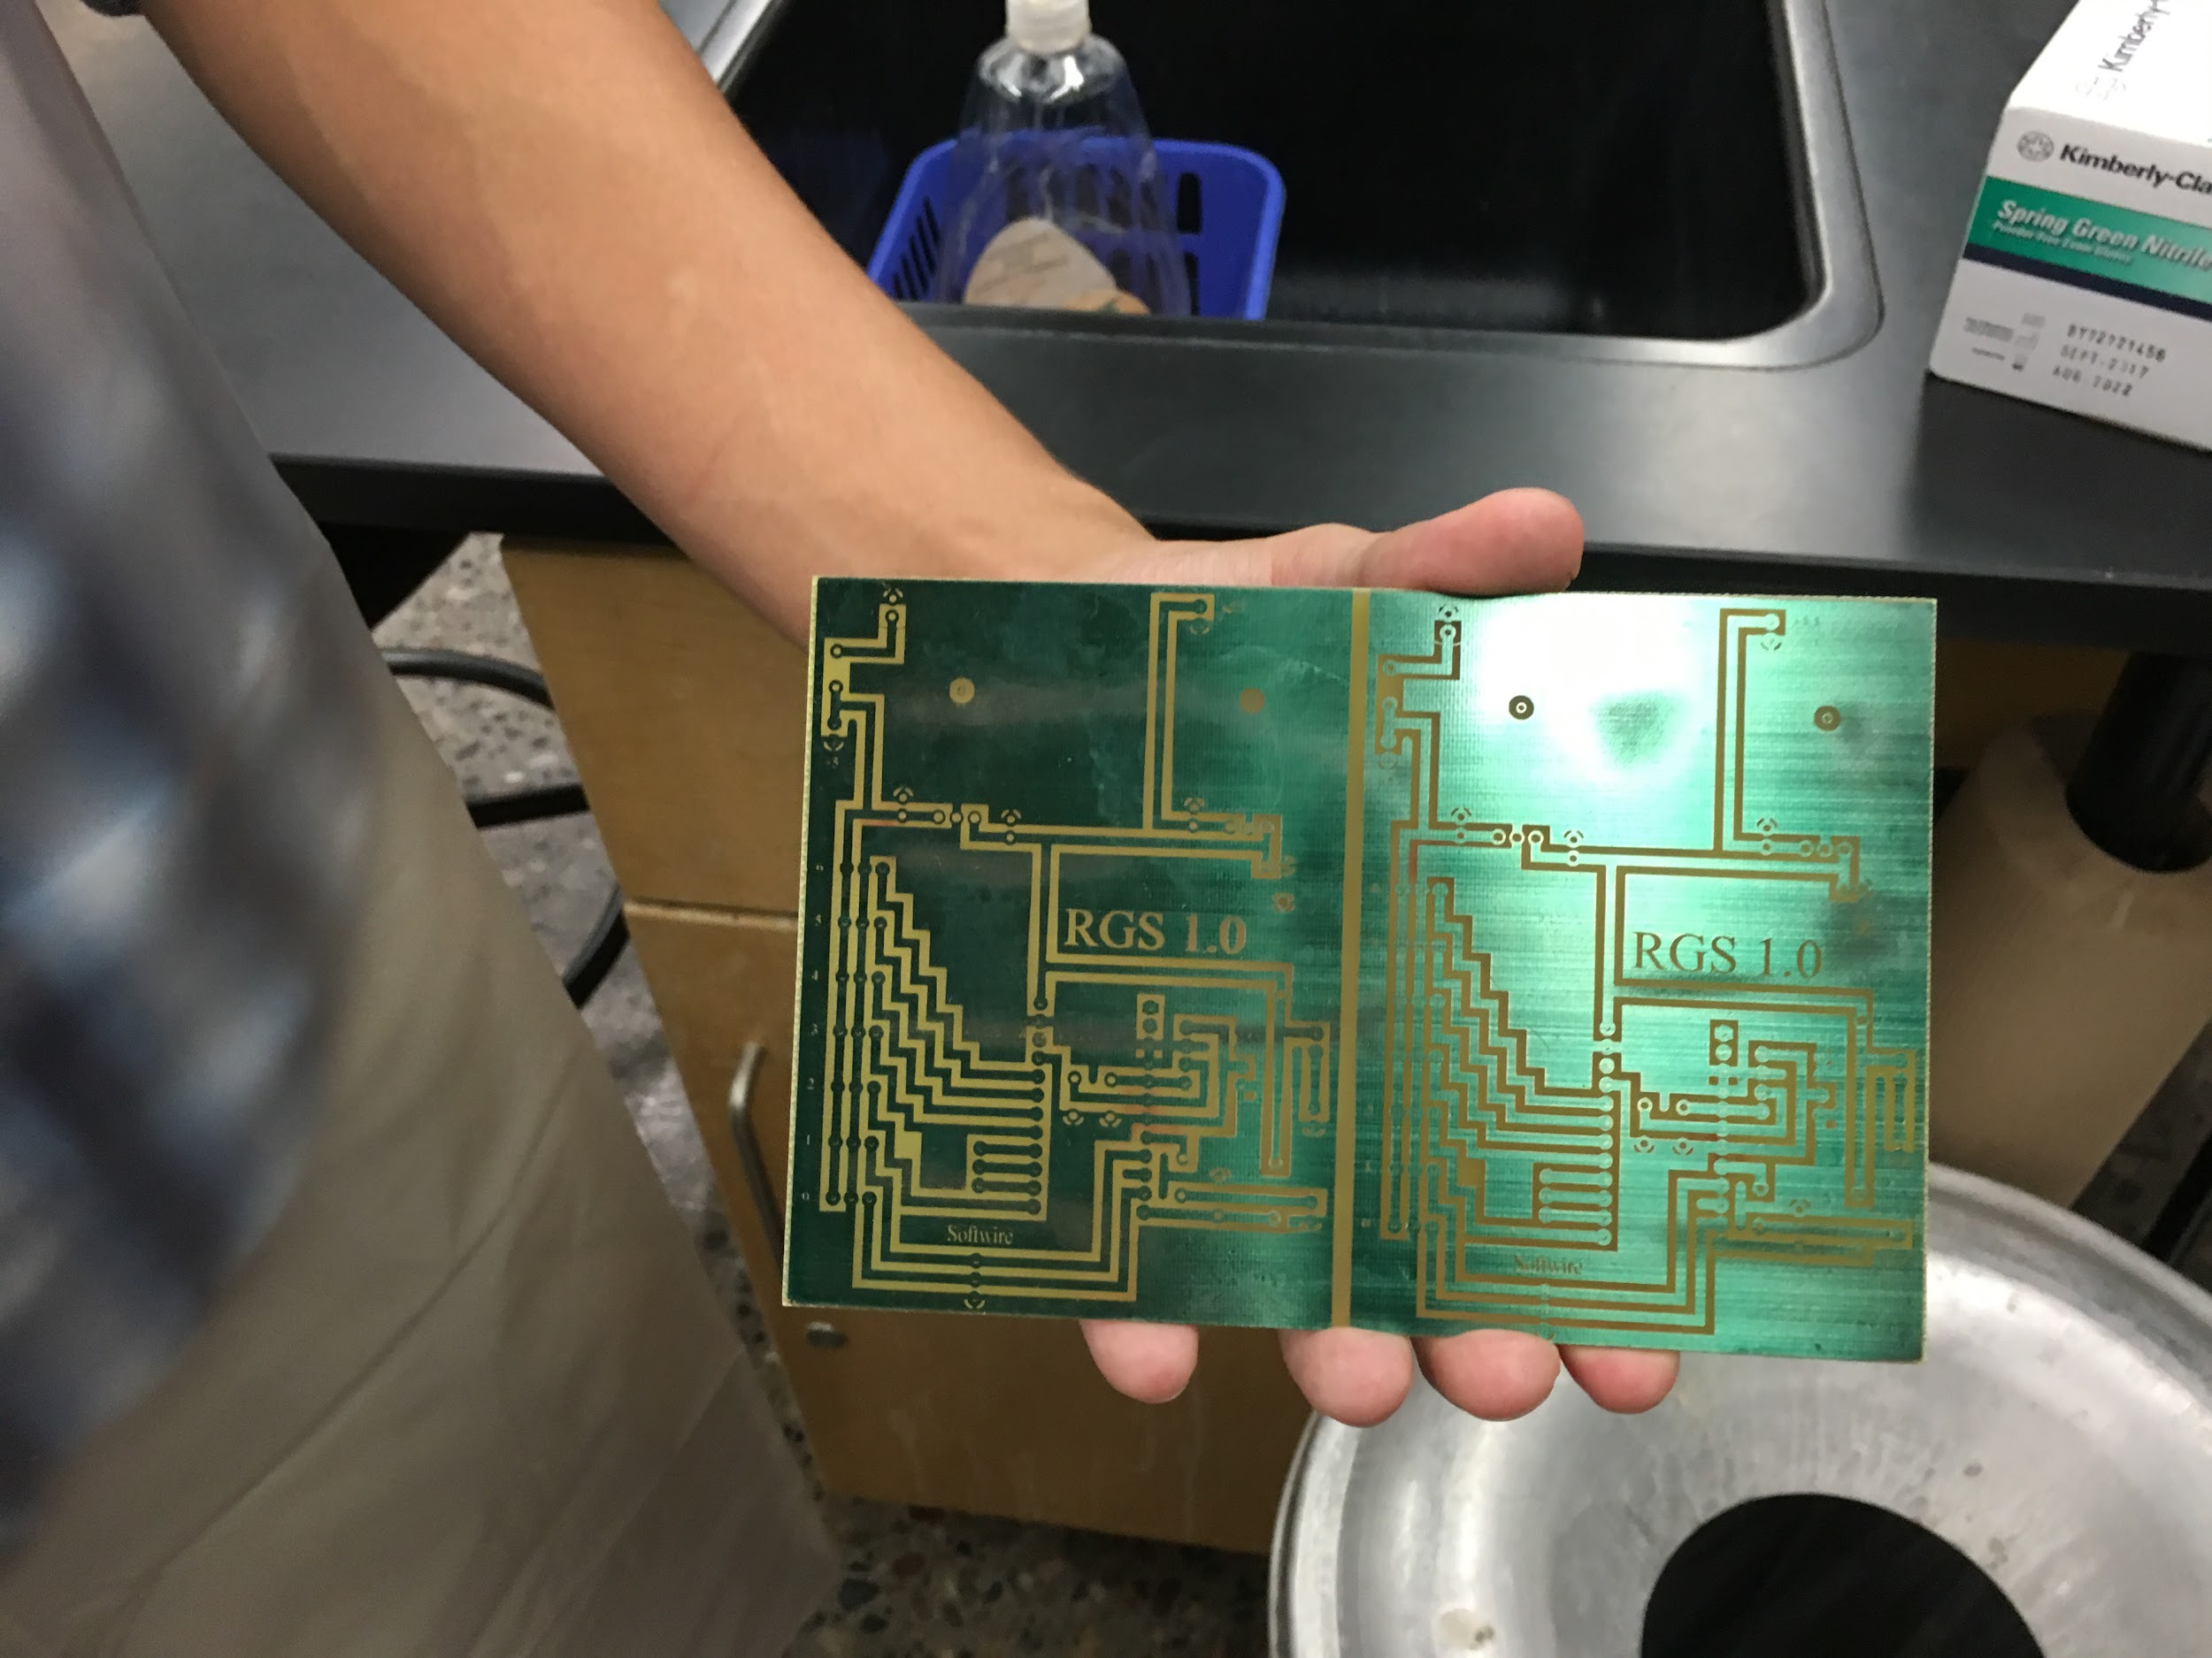
Etching the Circuit Board

Slide 7
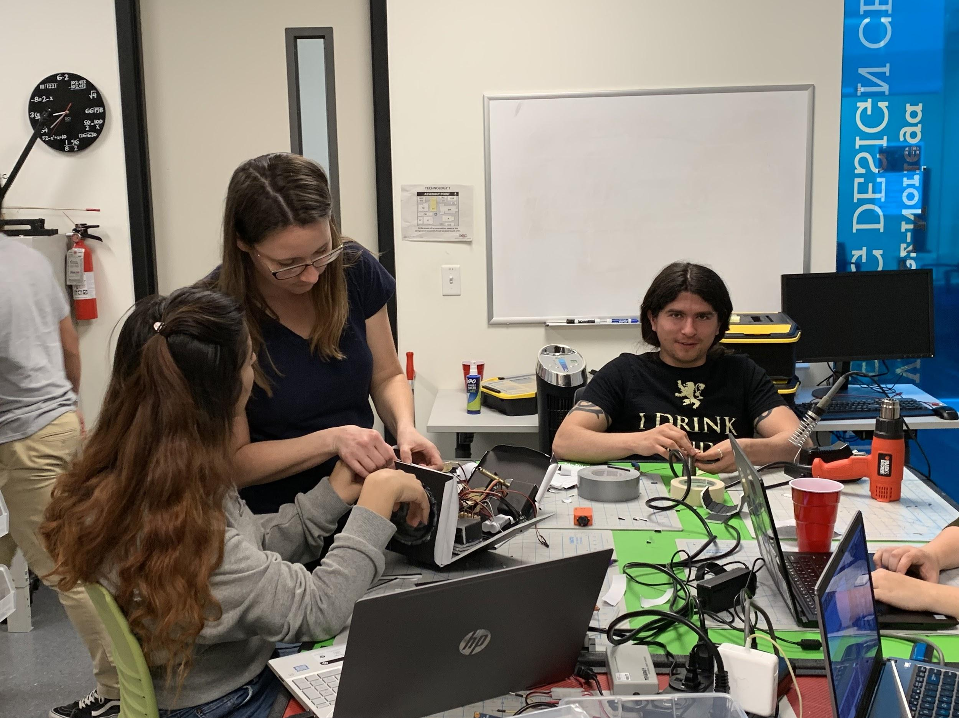
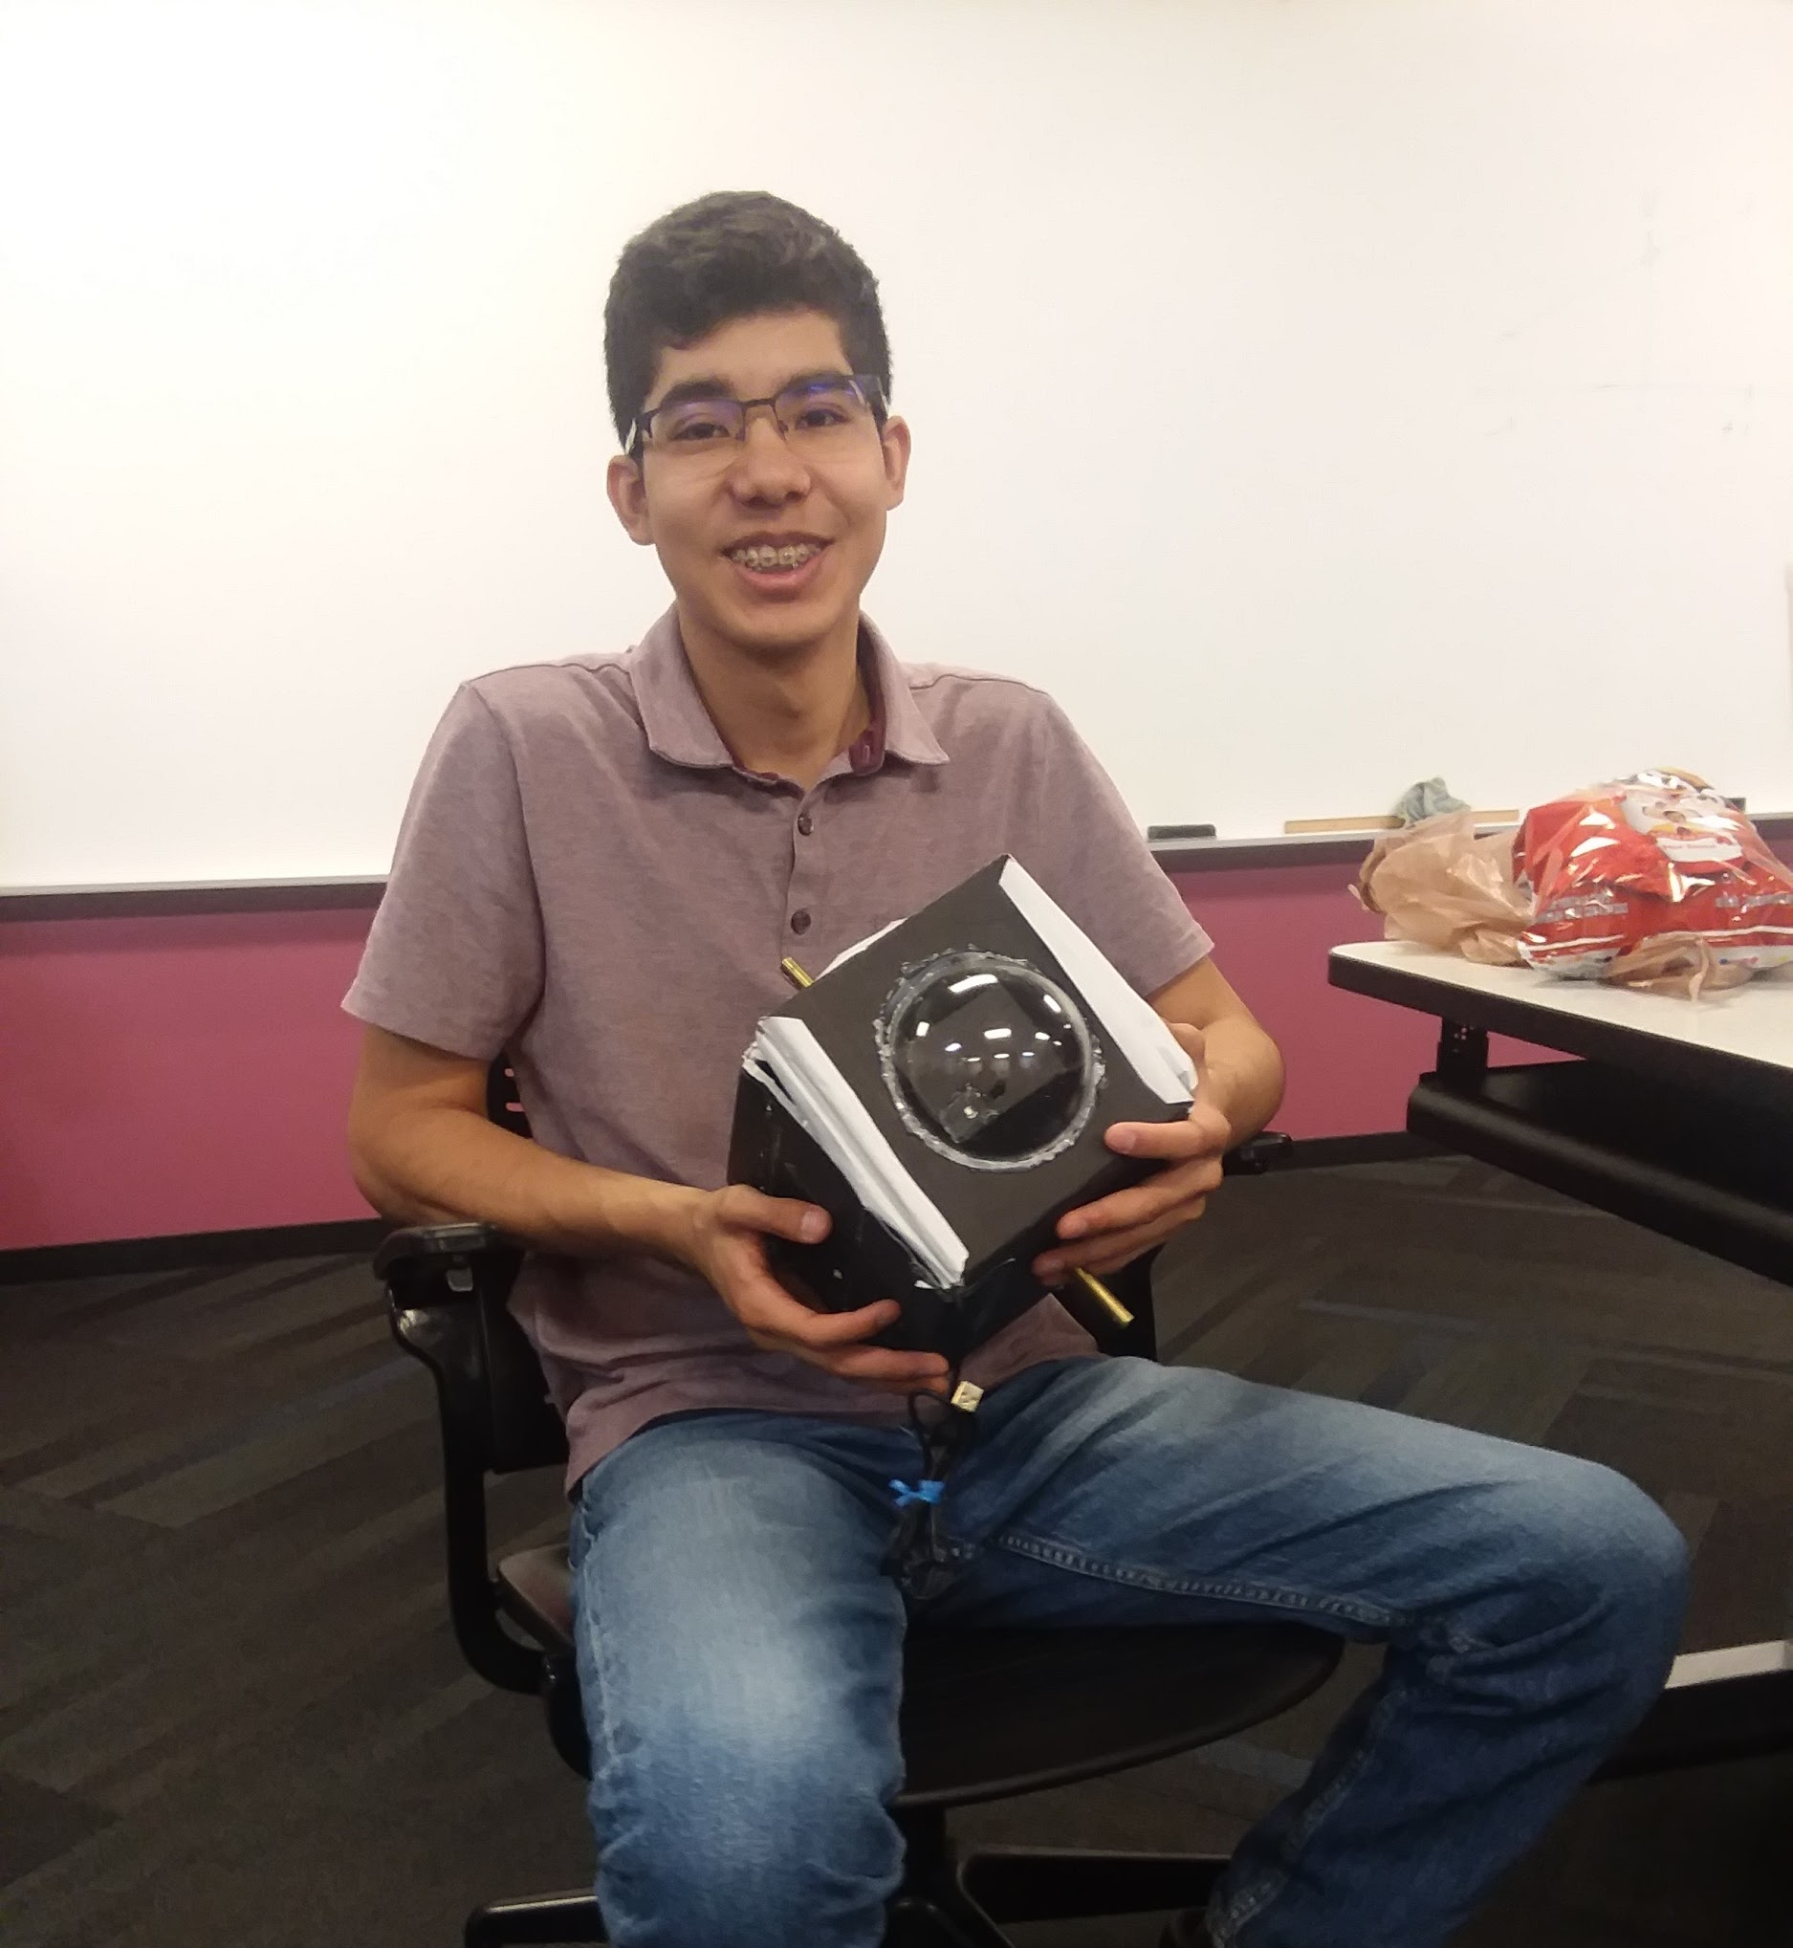
Constructing the payload

Slide 8
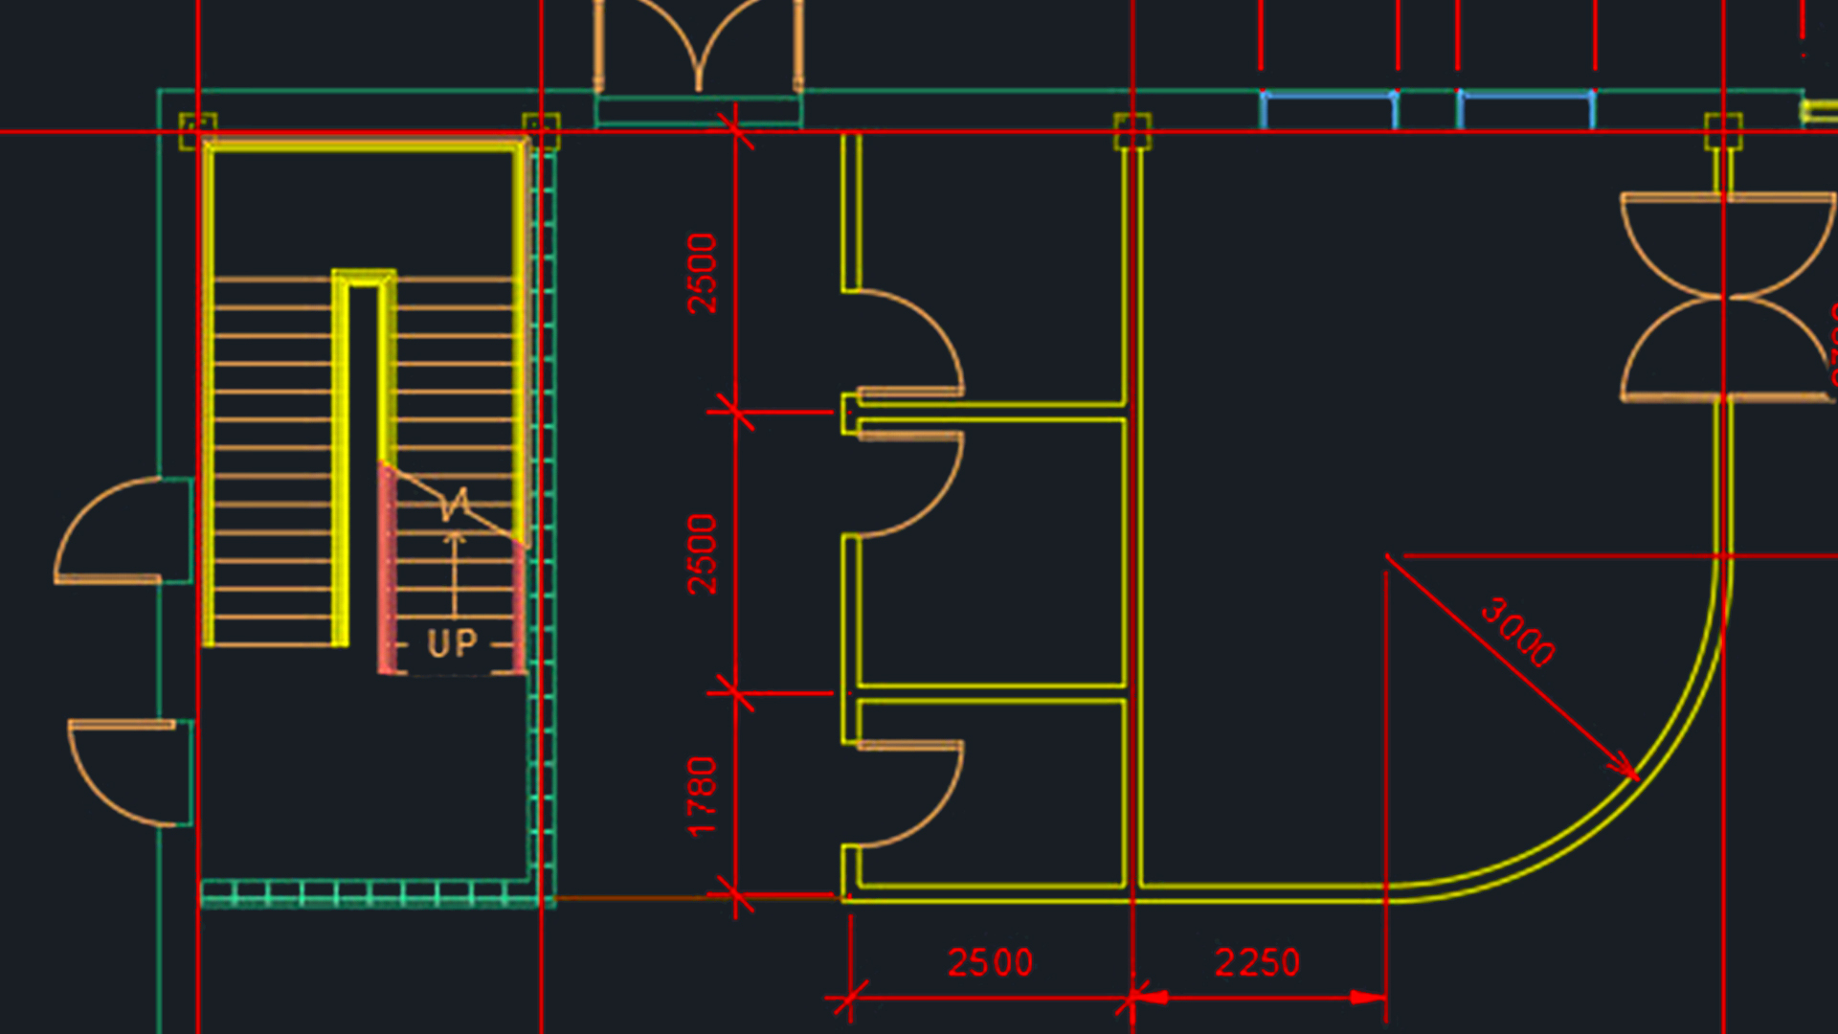
Global Navigational
Satellite System

Slide 9
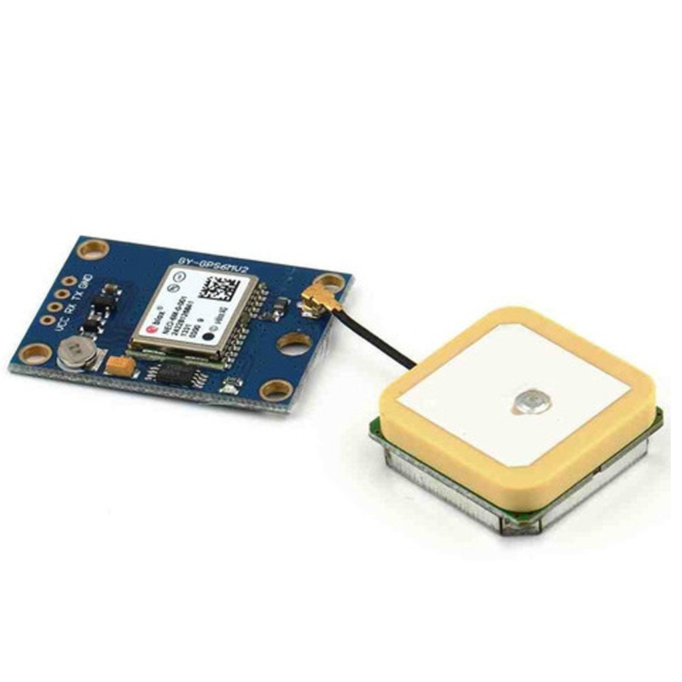
Positioning System
Can make use of all major satellite constellations
Accuracy improvement of 4x over GPS
Max 22 satellite fix
UBLOX NEO 6M-GPS

Slide 10
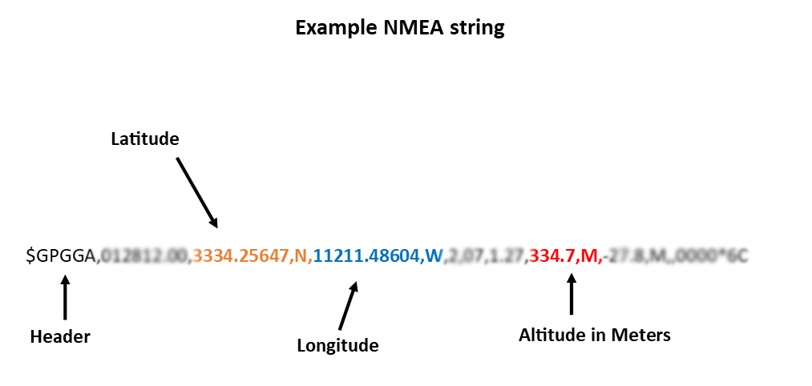
Positioning System Output
Data output in NMEA sentence
Sentence uses header $xxxxx to define information type
Sentence then parsed for necessary information
Position, Altitude data stored every 2 seconds

Slide 11

MODEM

Slide 12
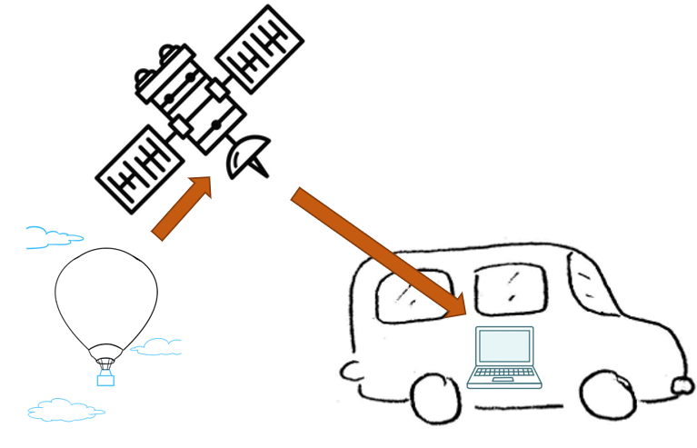
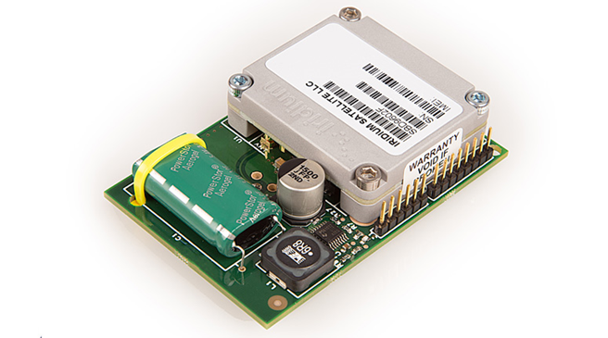
The RockBLOCK Modem
•It relies on the IRIDIUM constellation (66 satellites)
•Cost: 250$
•1¢ per byte

Slide 13
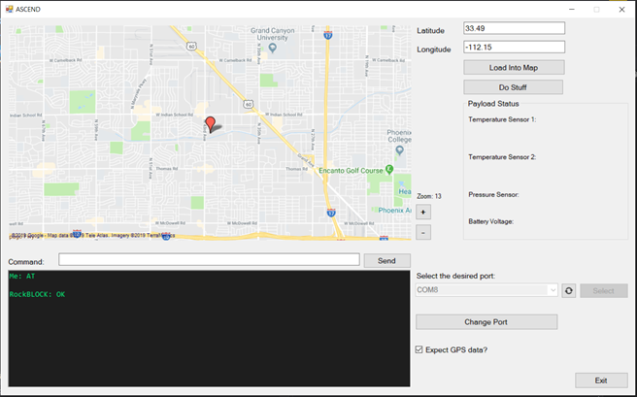
On the Ground / In vehicle
Temperature, pressure, battery voltage, current timestamp, and GPS data were received and interpreted.

Slide 14
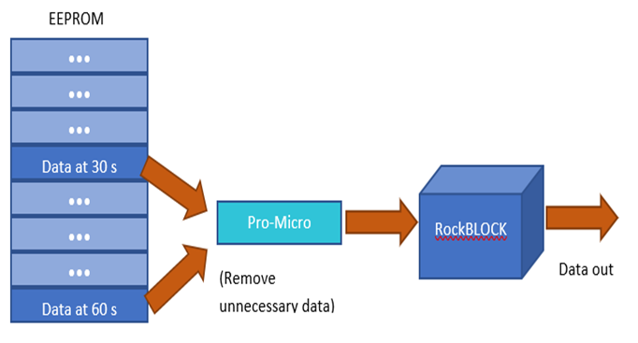
Inside the payload
50 bytes of data every minute.
Payload status at 30 and 60 seconds.

Slide 15

CAMERA

Slide 16
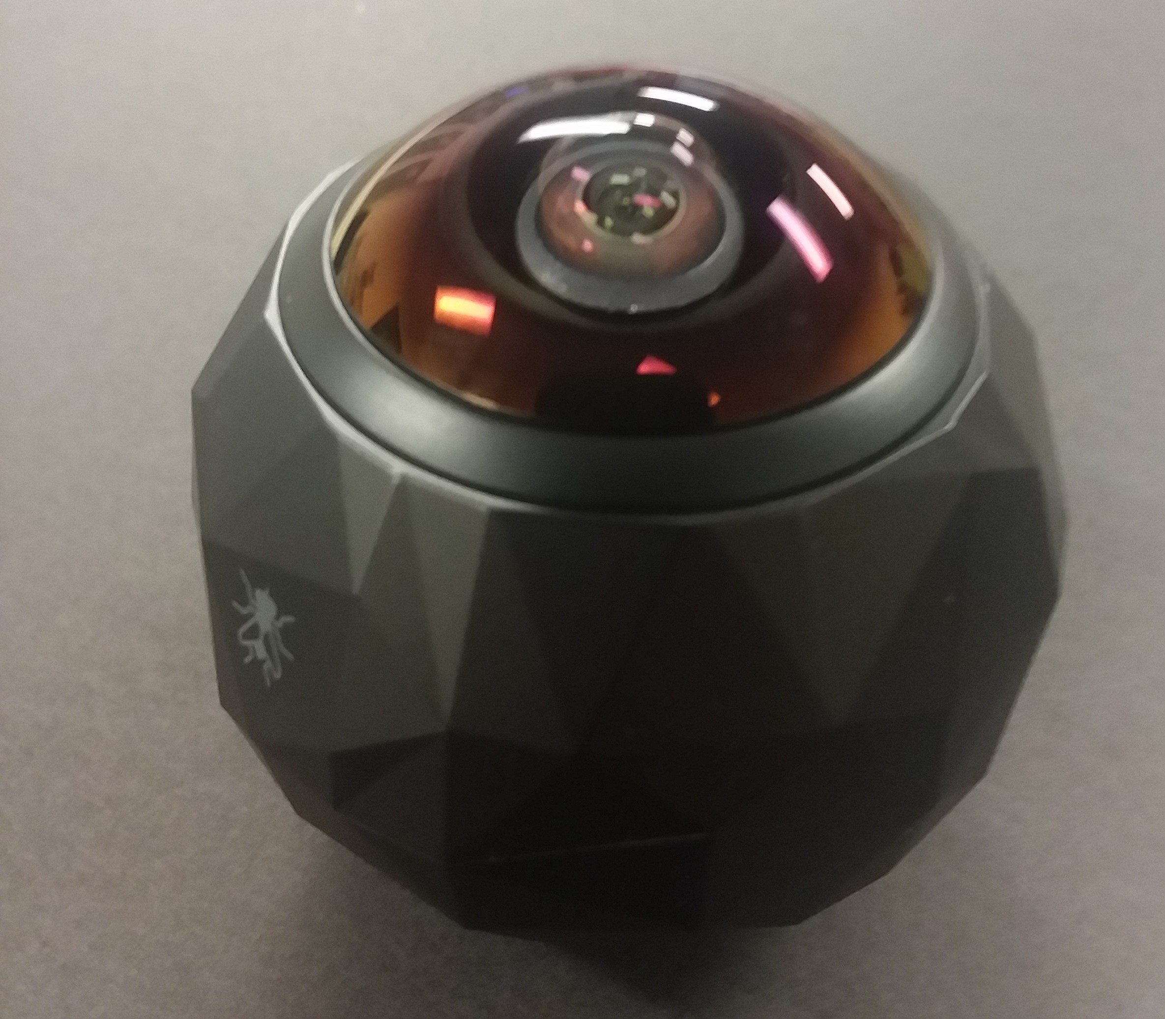
Fall 2018
360 Fly
360 HD Footage
Dustproof, shockproof, and water resistant
2+ hours of recording time

Slide 17
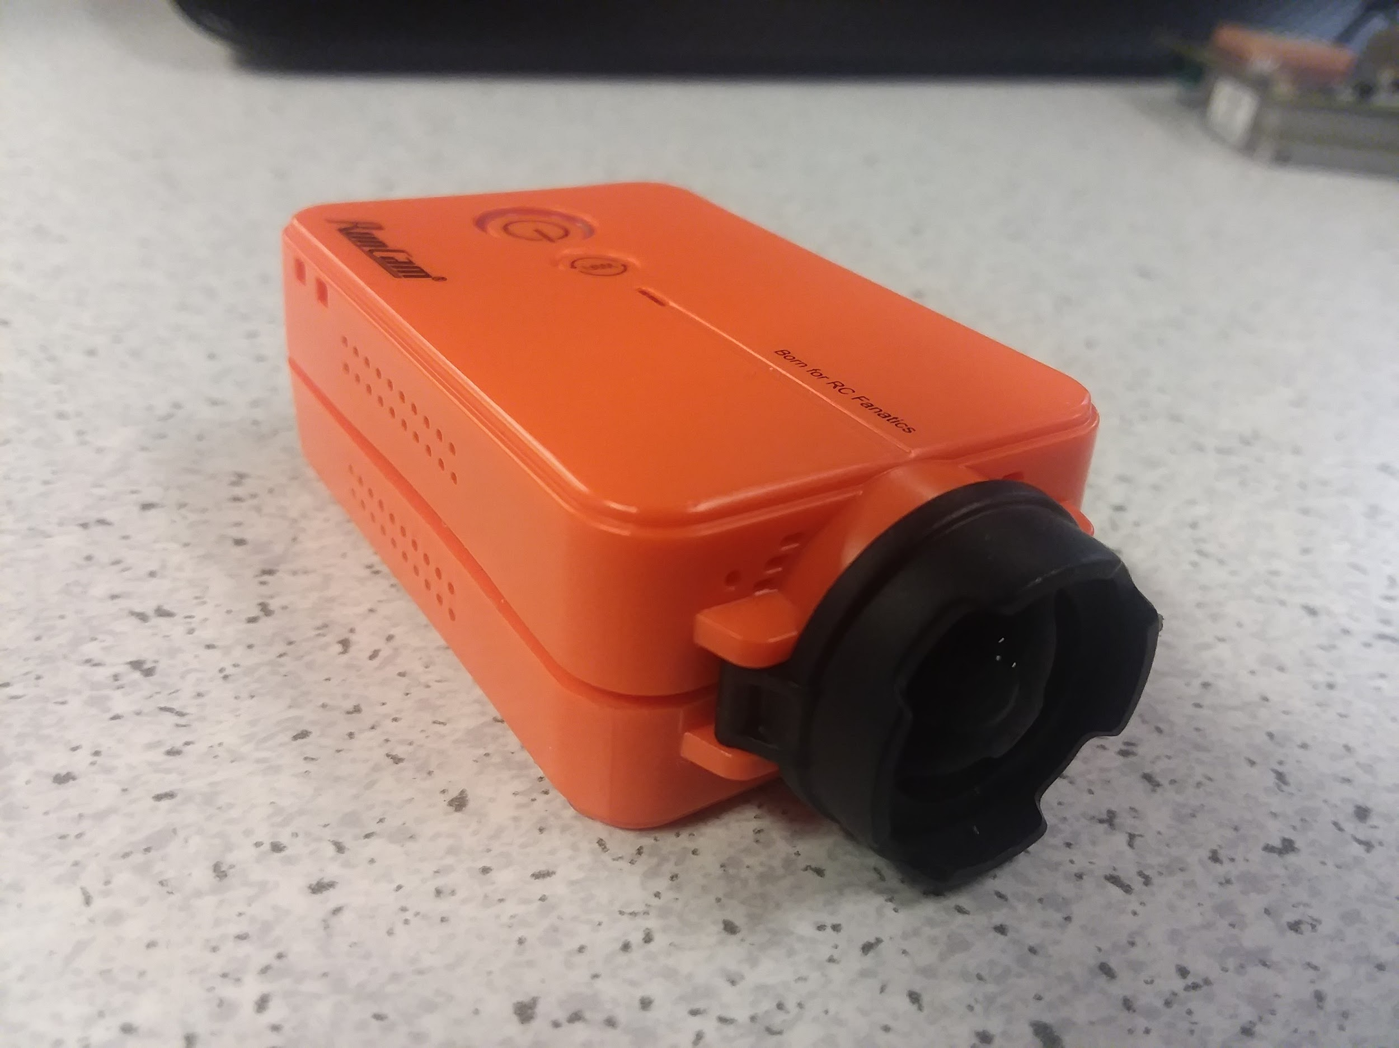
Spring 2019
RunCam 2

Slide 18
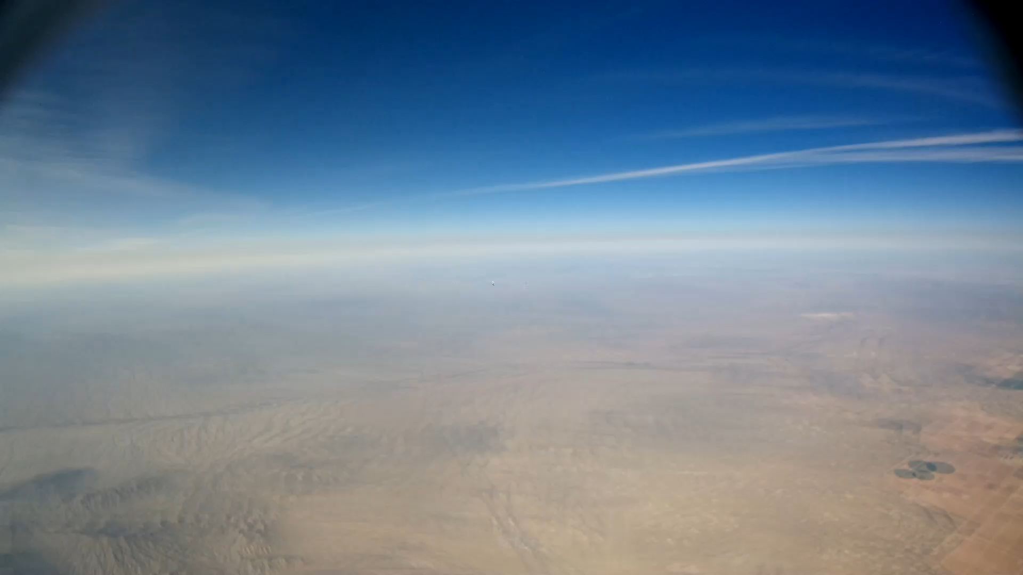

Slide 19
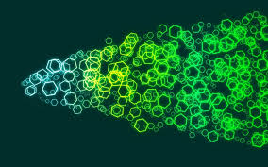
BACTERIA SURVIVAL

Slide 20
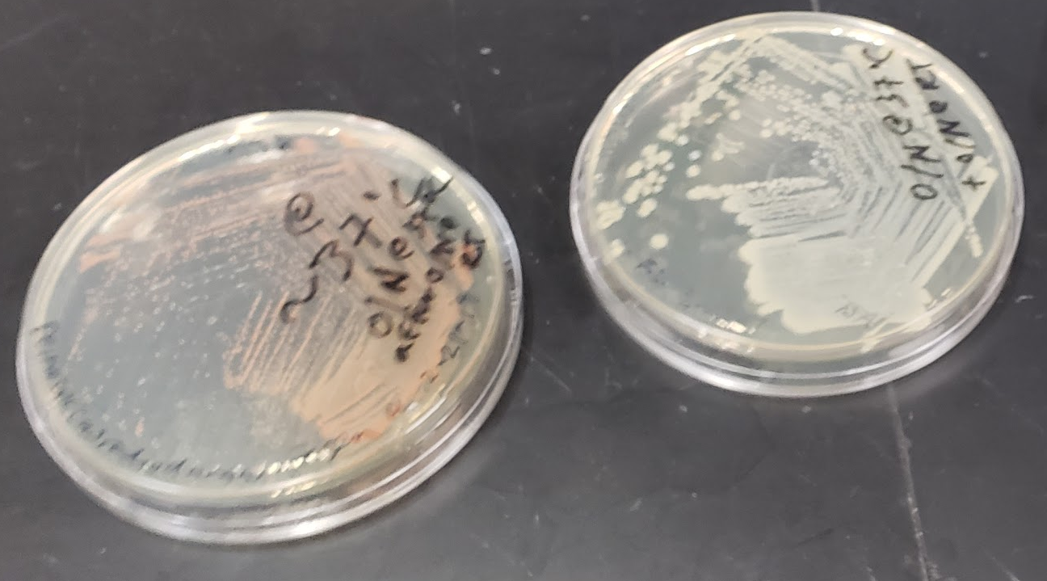
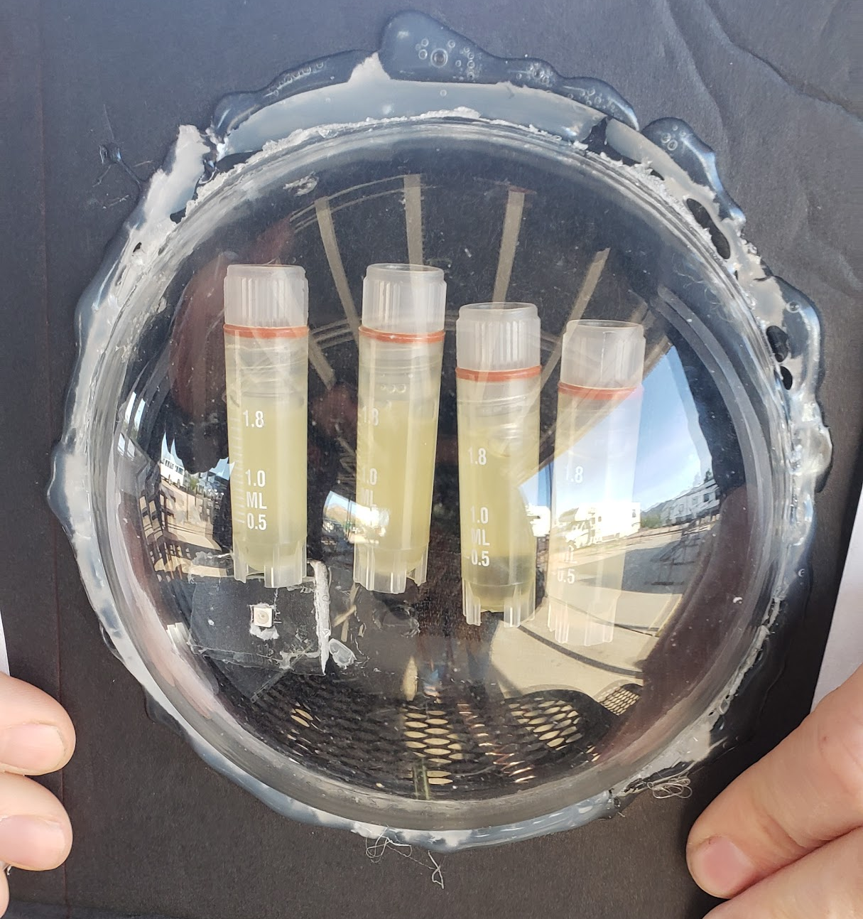
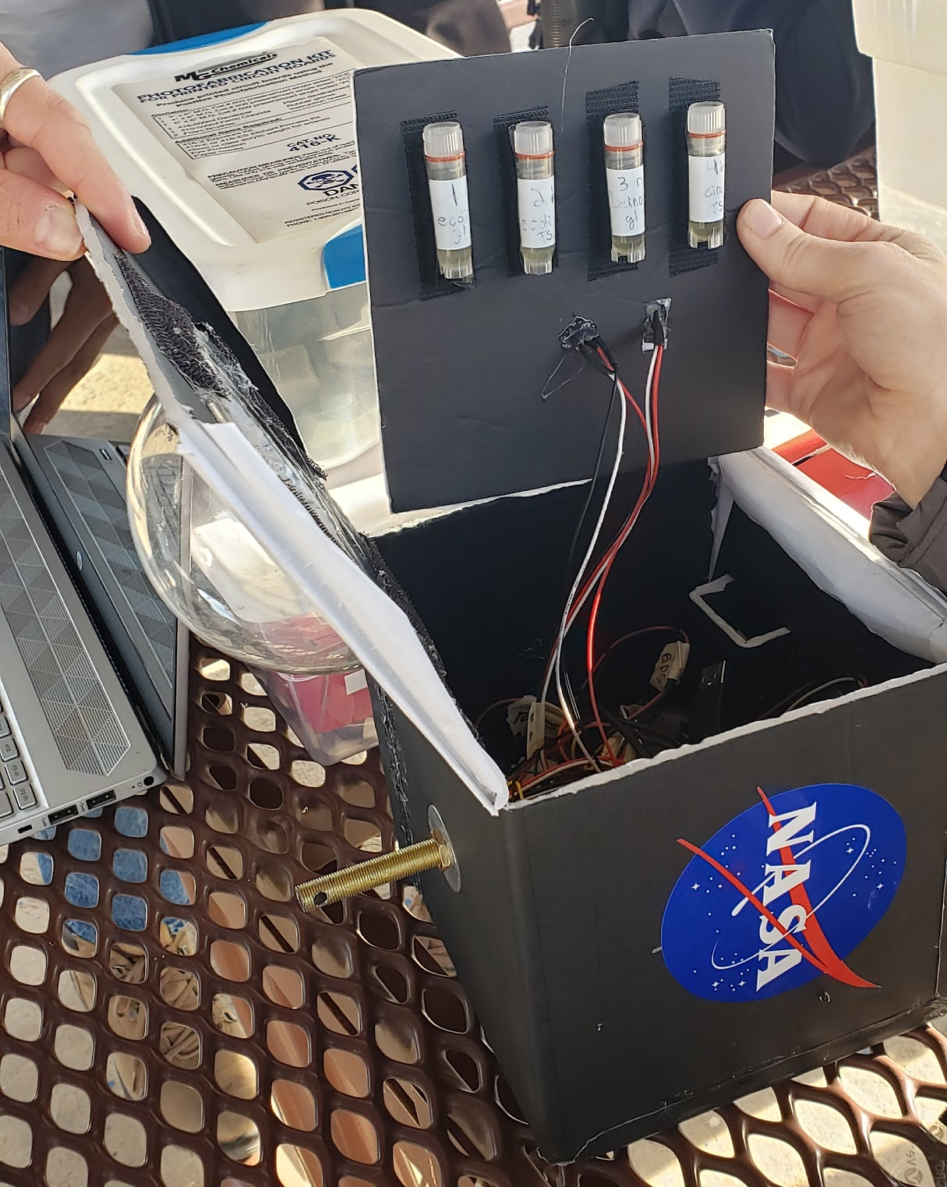
Deinococcus
Compared to control conditions on the ground.
Externally in Dome
Internal of Payload
Escherichia coli
Internal conditions :
Internal temperature range -> 35 F to 90 F
Pressure range -> 0.94 atm to 0.02 atm
Dome conditions:
Temperature range -> 10.4 F to 116 F
Pressure range -> 0.95 atm to 0.02 atm
UV Index range -> 1 to 6

Slide 21
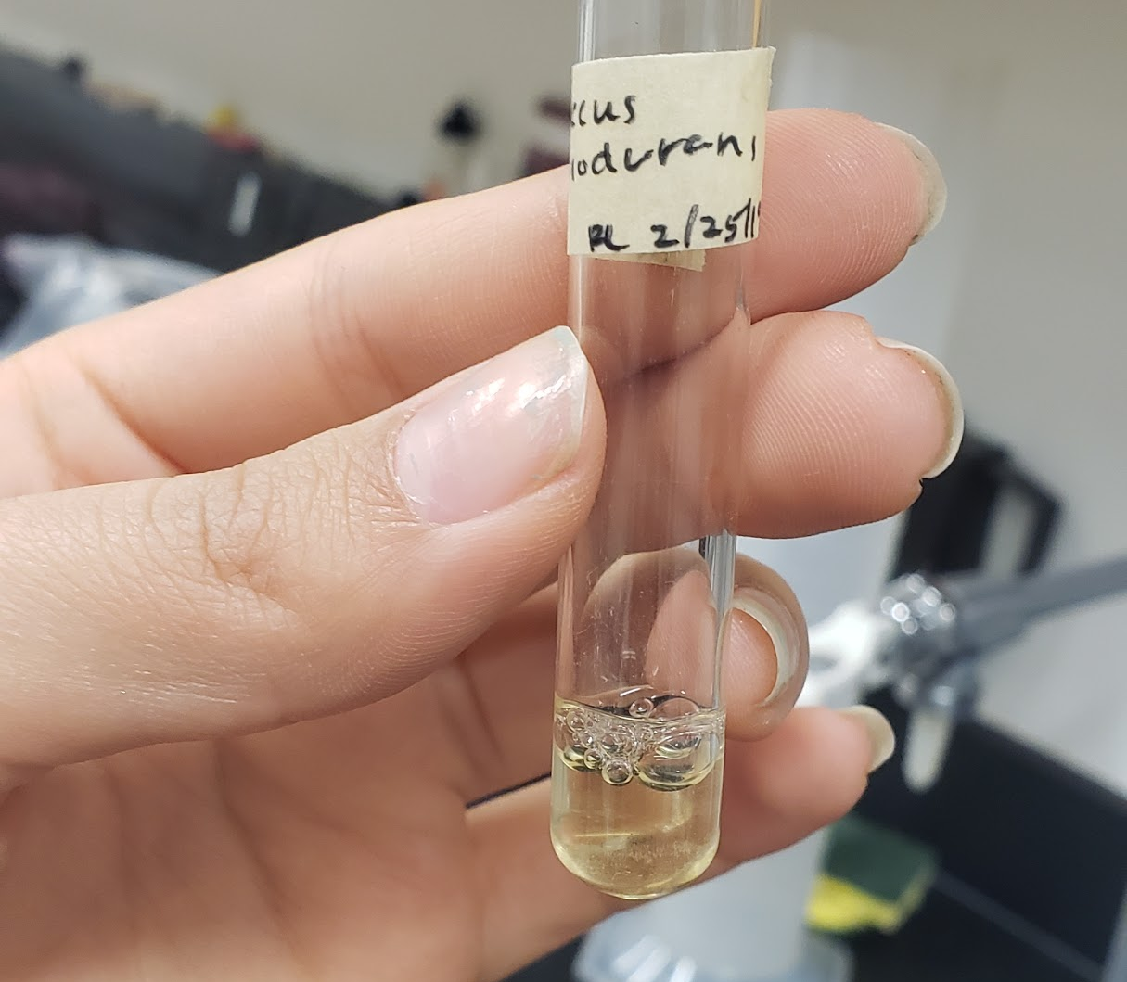
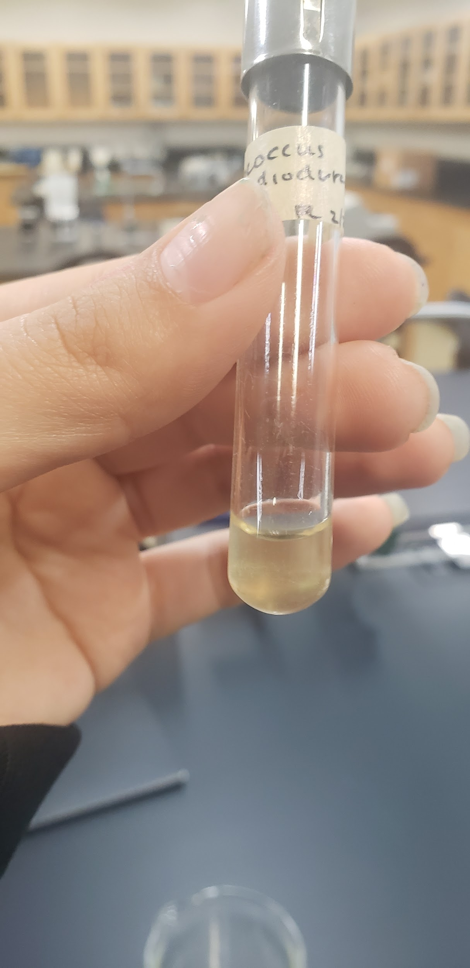
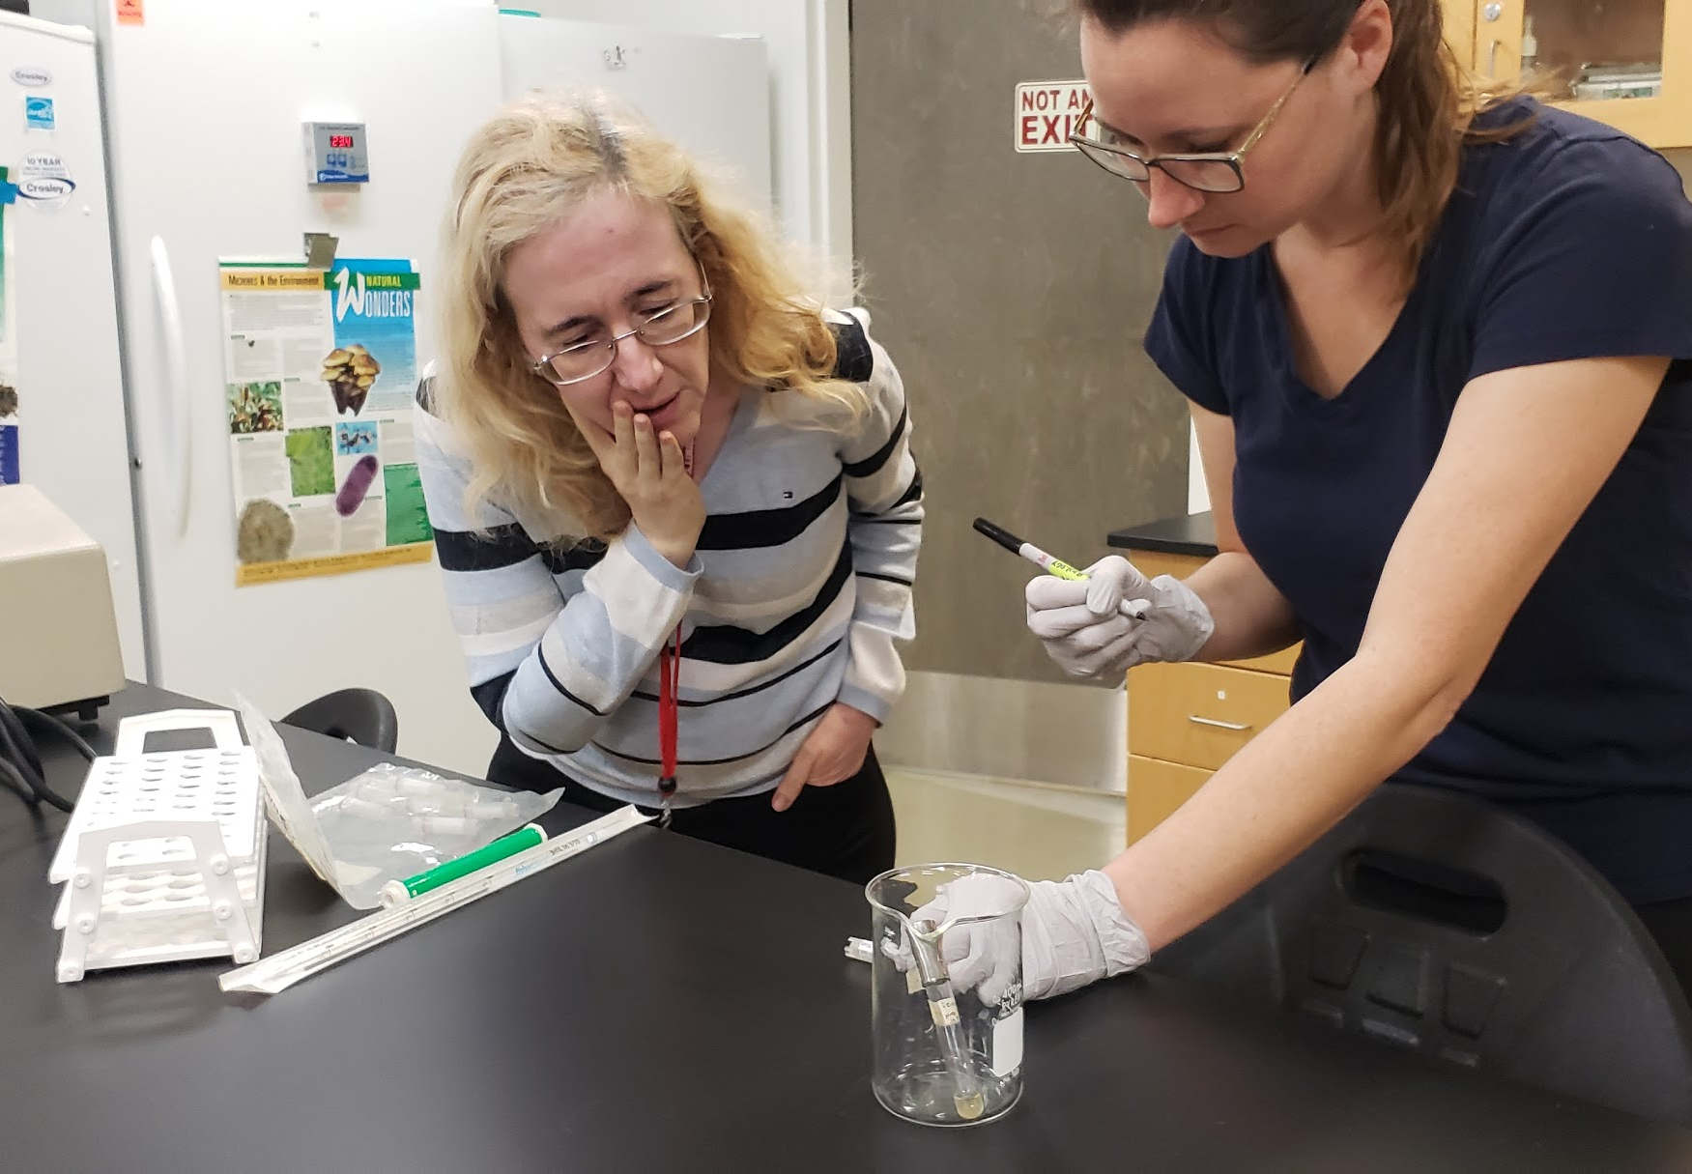
TESTS AND CHALLENGES :
WHAT COMMON MEDIA IS BEST TO DECREASE THE VARIABLES?
Both bacterias were tested on same temperature of 37 celcius over two nights to find common media.
Liquid TS (Typticase Soy Agar).
WOULD DEINOCOCCUS SURVIVE LOW TO ZERO OXYGEN?

Slide 22
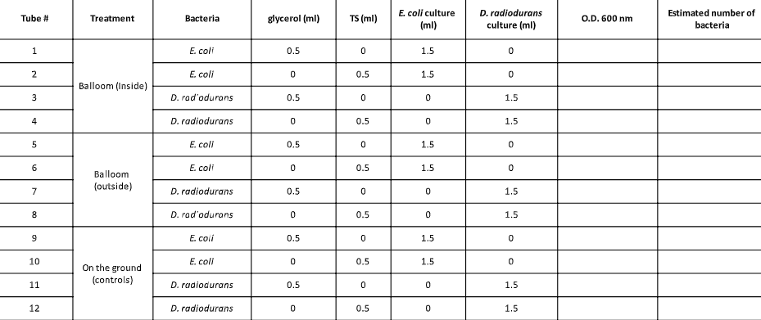
Bacteria/Media Ratios and Results Table:

Slide 23
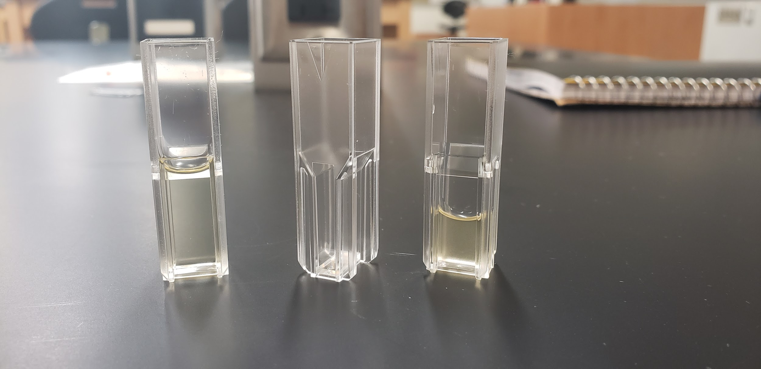
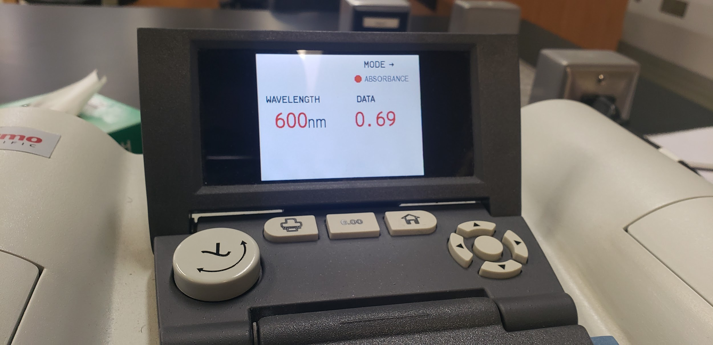
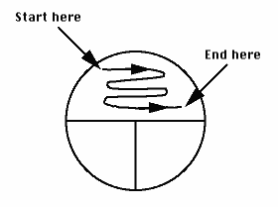
Biological Testing Methods:
Spectrophotometer:
Determine the optical density of a bacteria culture.
Streak plate to isolate colonies.

Slide 24
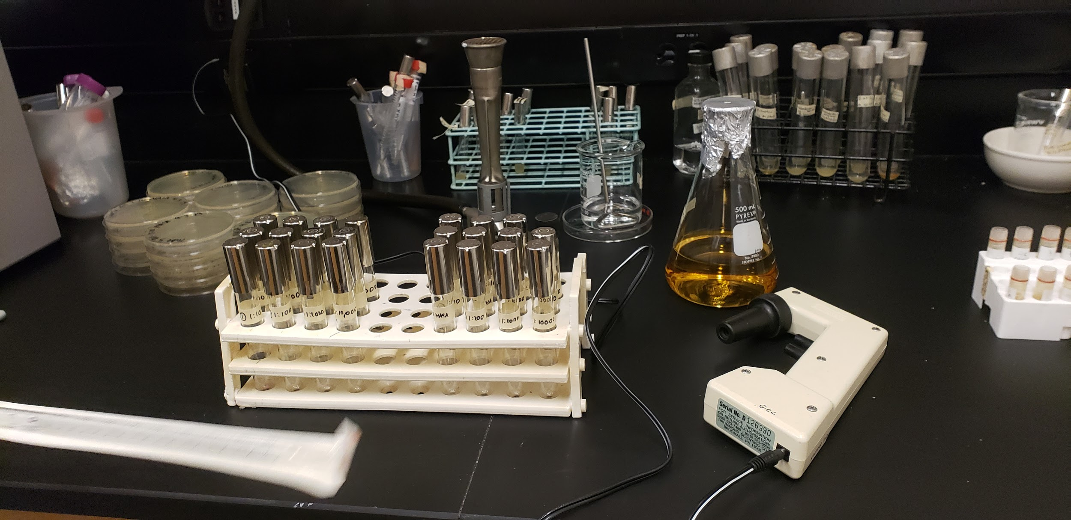
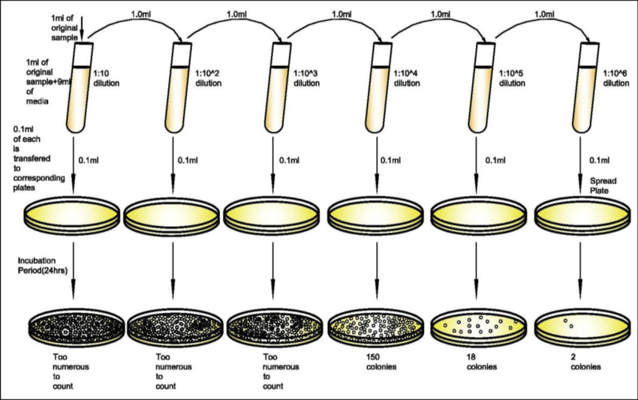
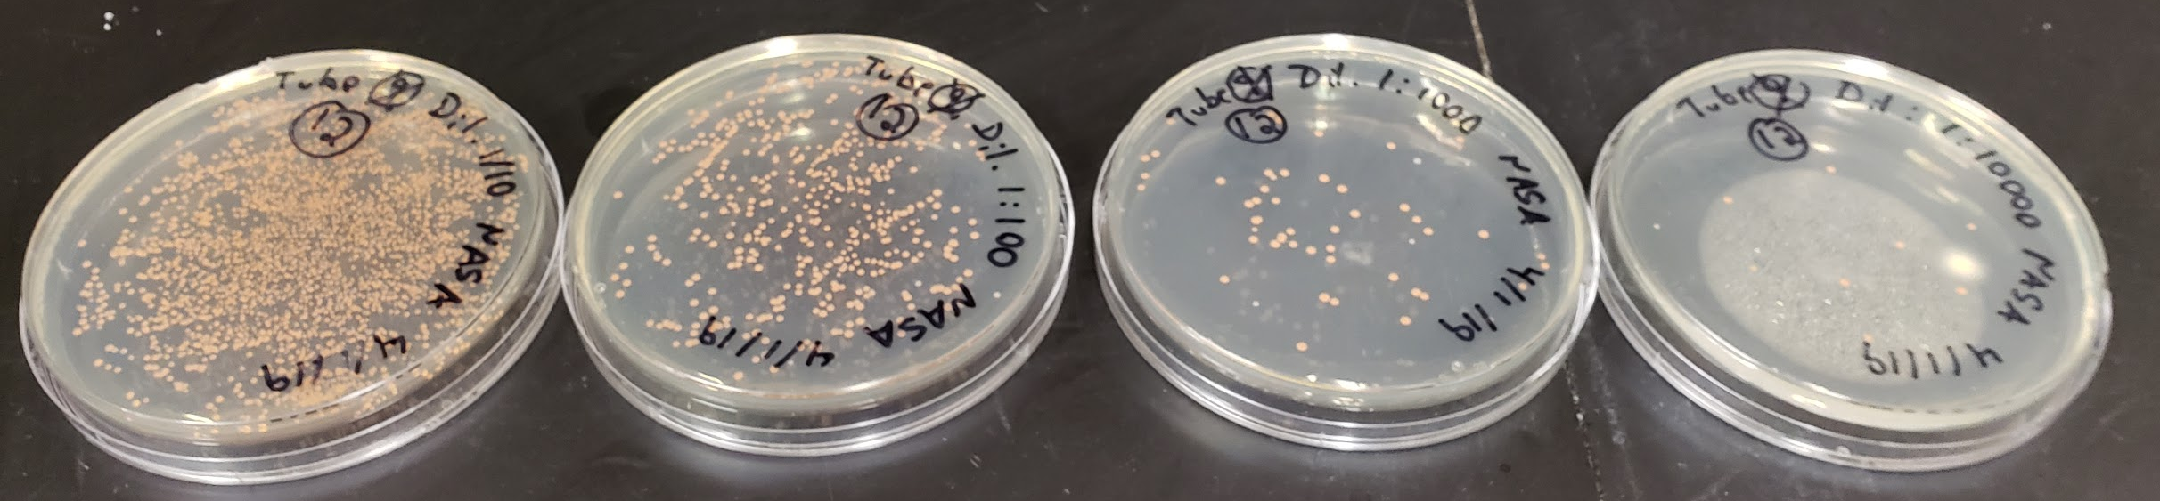
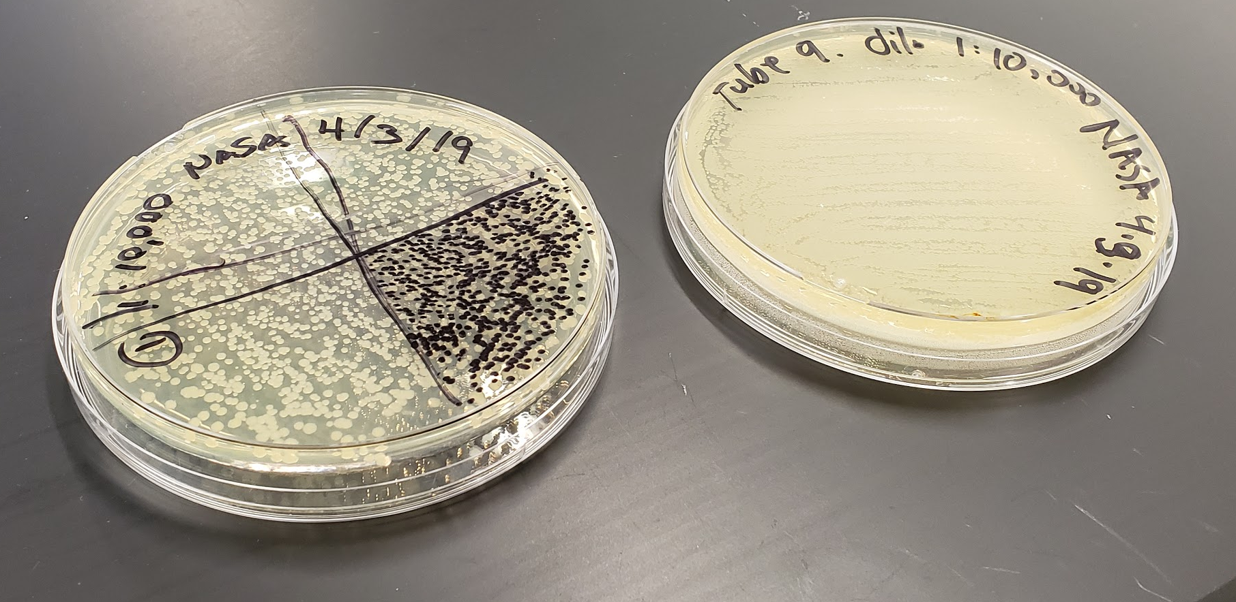
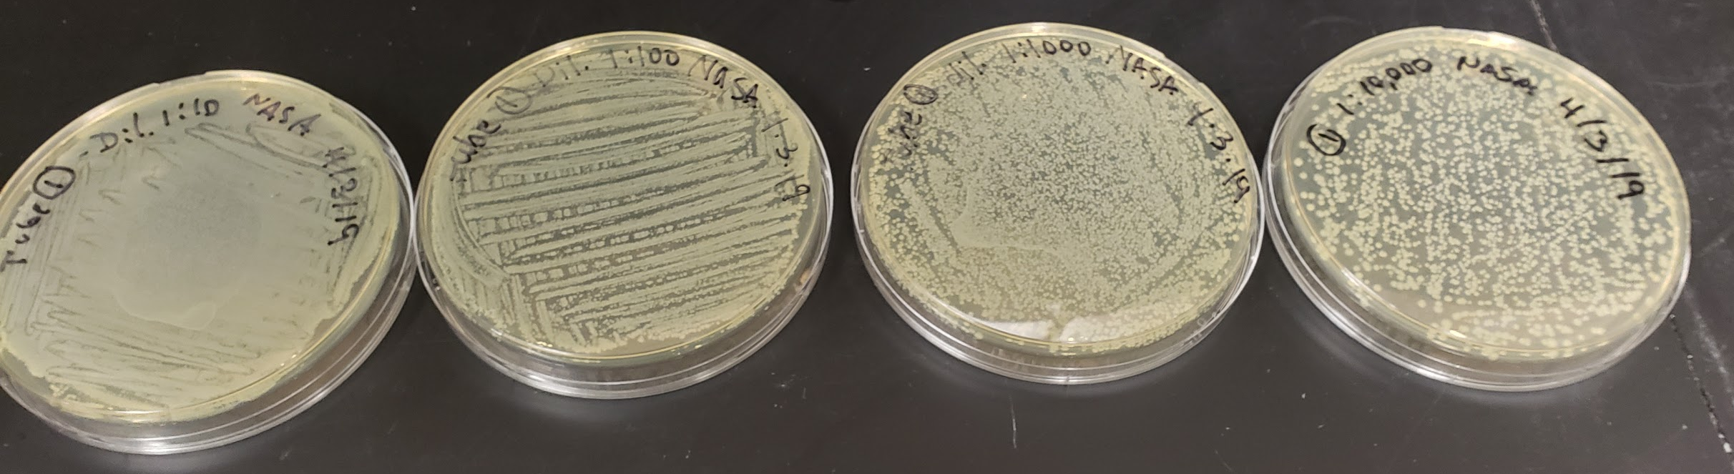
Dilution and Plate Count:

Slide 25
Results:
Inside: Both bacterias survived with lower growth comparing to controlled ones.
Outside: Both bacterias died.
Controlled: Both bacterias grew in higher rated comparing to the inside ones.

Slide 26
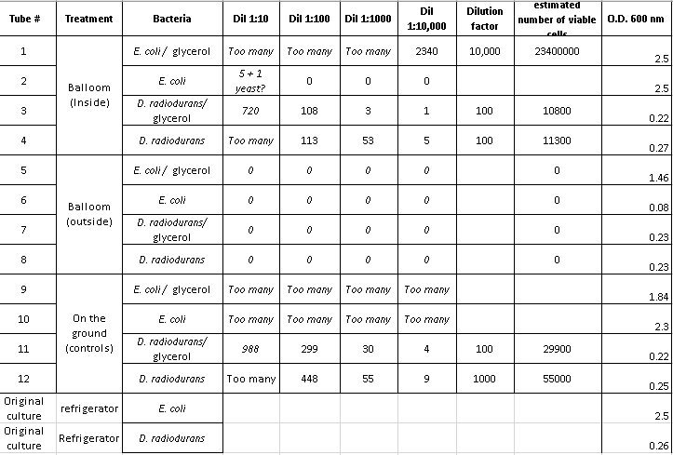

Slide 27
Future Improvements:
Do replicas of each vial.
Design the payload so that the bacteria in the dome experiences actual atmospheric temperatures.
Include a GEIGER Counter for radiation.

Slide 28
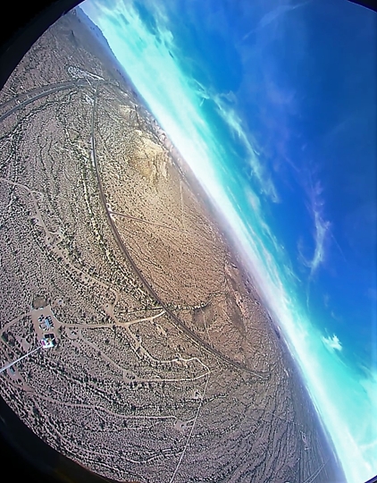

Slide 29
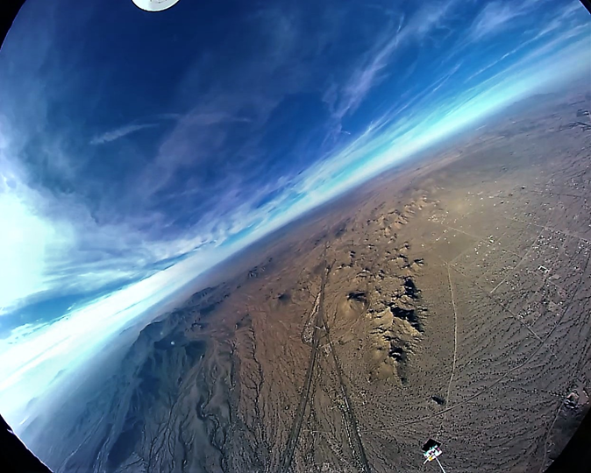

Slide 30
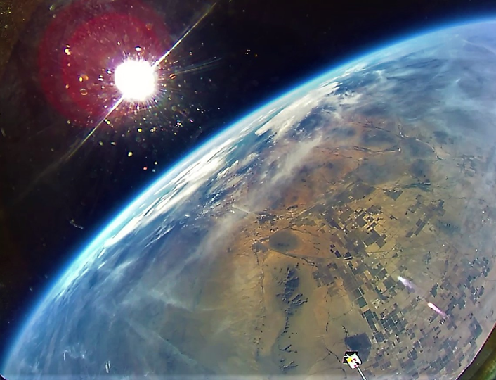

Slide 31
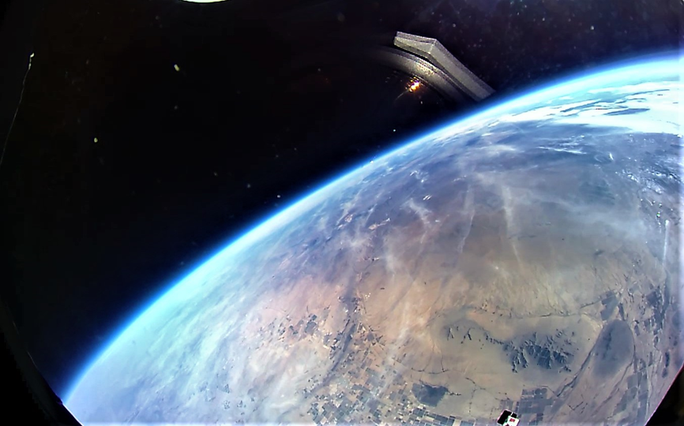

Slide 32
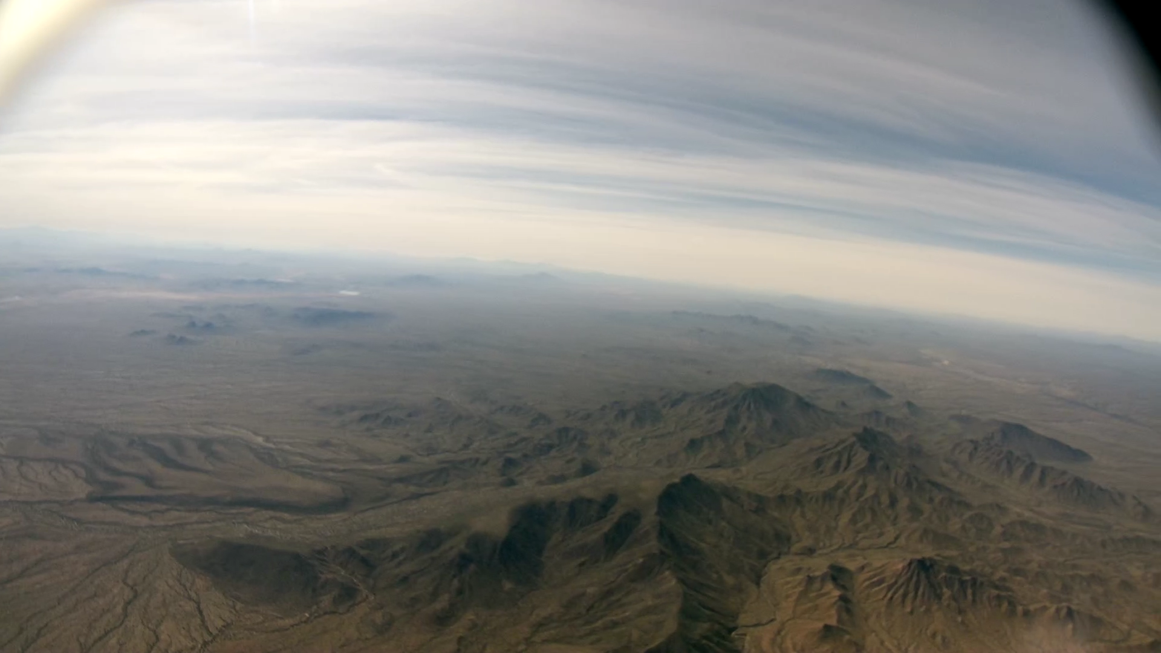

Slide 33
Data

Slide 34
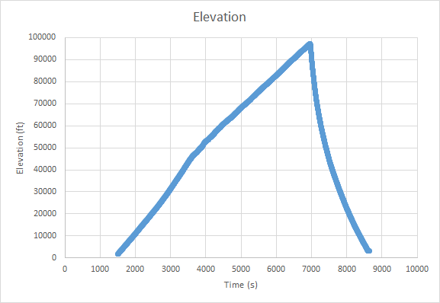
Elevation Spring 2019
Traveled up to 96,000 ft at ~17.5 ft/s
Traveled down to 0 ft at ~60 ft/s
Launch ~1500s, balloon burst ~7000s, landing ~8700s. Total flight time 120 min.

Slide 35
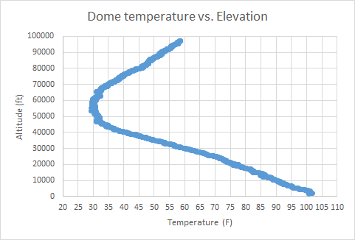
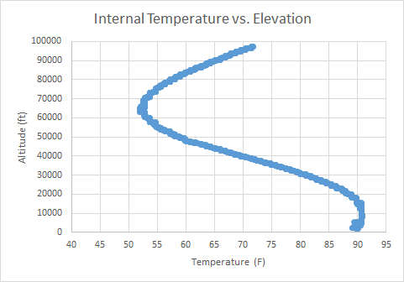
Temperature vs. Elevation

Slide 36
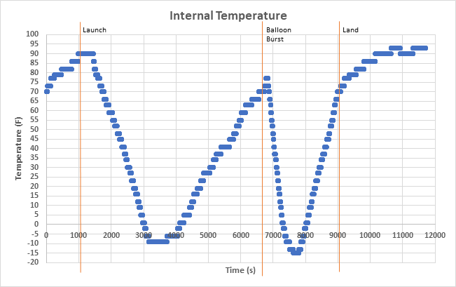
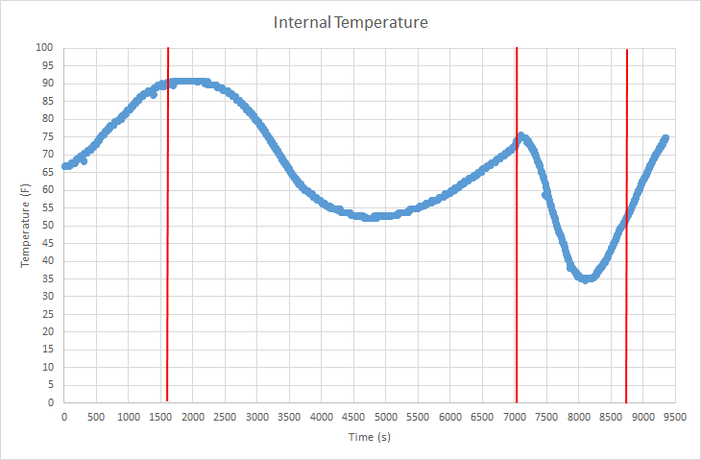
Internal Temperature
Fall 2018
Spring 2019
Notes:
Data analysis covers a full collection time from pre-launch to recovery of 11,867s. Launch time began at 1380s. The payload traveled at approximately 19.5ft/s until the balloon burst at 106,600 feet at 6,780s and landed at 9,000s. Min -15F (-26C)

Slide 37
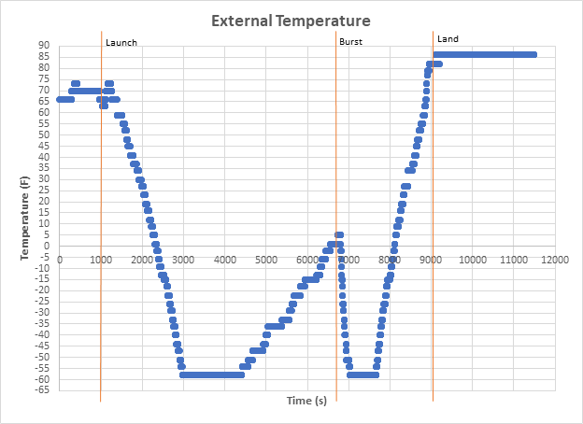
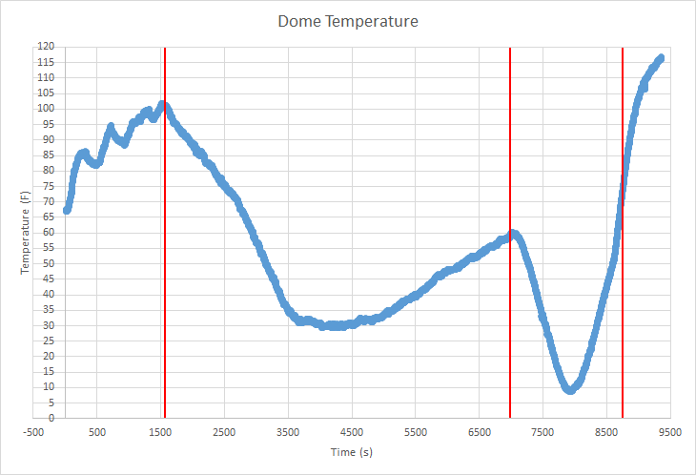
External Temperature
Fall 2018
Spring 2019

Slide 38
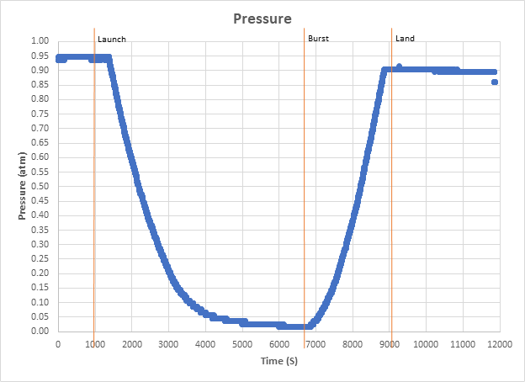

Pressure
Fall 2018
Spring 2019
Notes:
Begins at a maximum of 0.95atm at a launch altitude of 1,200ft and decreases to a minimum of 0.02atm at the time of balloon burst at an altitude of 106,600ft observing a similar reverse pattern as the payload descends again reaching 0.91atm at a landing altitude of 1,490ft.

Slide 39


Acceleration X-direction
Fall 2018
Spring 2019

Slide 40


Acceleration Y-direction
Fall 2018
Spring 2019

Slide 41


UV Index
Fall 2018
Spring 2019
Notes:
Many factors account for changes in UV index such as time of day, cloud cover, ozone levels, etc. The data depicts a general trend in which the UV index increases with elevation and time of day

Slide 42


THANK YOU
Dr. Tim Frank Rick Sparber
Dr. Lucrecia Alvarez Rhonda Lee
Arizona Space Grant NASA ANSR

Slide 43

Questions?

